Slide 1

CMR COLLEGE OF ENGINEERING & TECHNOLOGY Kandlakoya, Medchal, Hyderabad - 501401 Department of AIML
Extracting Roads from Satellite Data
For Effective Disaster Response
Batch No.:22
Name of the student: S. Mukunda 21H51A7316
Ch. Rohith 21H51A7329
N. Anuradha 21H51A7354
Under esteemed guidance of
Guide Name: Ms. A. Himabindu
Designation: Asst. Professor
Batch: 2021-2025 Major Project Phase 1

Slide 2
outline
Abstract
Introduction
Research Objective
Problem Definition
Scope of the Project
Literature Review
Implementation of Proposed System
Conclusion
References

Slide 3

ABSTRACT

Slide 4
abstract
This project “Extracting Roads from Satellite Data” is a crucial step in effective disaster response.
Roads are detected and extracted using various methods like edge detection, segmentation, classification, object-based image analysis.
The extracted roads are then analyzed to identify damaged or blocked roads, asses road connectivity, accessibility & detect changes in road networks.
The extracted road data is integrated with other relevant information.
This results in accuracy road data which helps emergency responders understand the situation on the ground & identifying accessible roads ensures resources reach those in need.
By leveraging advanced technologies and techniques, extracting roads from satellite data can significantly enhance disaster response efforts, ultimately saving lives and reducing suffering.

Slide 5
INTRODUCTION

Slide 6
introduction
Road extraction in urban areas has been an important task for generating geographic information systems (GIS).
Especially in recent years, the rapid development of urban areas makes it urgent to provide up-to-date road maps.
The timely road information is very useful for the decision-makers in urban planning, traffic management and car navigation fields, etc.
Nowadays, we are experiencing an explosion in the amount of satellite image data, which provides us abundant data and also brings challenges to the road extraction task at the same time.
The conventional road extraction methods by manual are time consuming and tedious, and cannot meet the increasing requirement for such tremendous data.
Therefore, it has drawn considerable attention of many researchers on how to develop automatic road extraction systems.
And much work has been done for this task. However, automatic extraction of urban roads from high resolution remote sensing imagery is still a challenging problem in digital photogrammetric and computer vision.
The main reason is that the diverse road surfaces and the complex surrounding environments such as trees, vehicles and shadows induced by high buildings make the urban roads take on different textures and gray levels in images.

Slide 7
RESEARCH
OBJECTIVE

Slide 8
research objective
The primary objective of the project is to develop a system that can automatically identify and extract road networks from satellite imagery.
This information is crucial for effective disaster response, as it provides critical infrastructure data that can be used to.
We propose a new approach based on machine learning.
First, many features reflecting road characteristics are extracted, which consist of the ratio of bright regions, the direction consistency of edges and local binary patterns.
Then these features are input into a learning container, and adaboost is adopted to train classifiers and select most effective features.
Finally, roads are detected with a sliding window by using the learning results and validated by combining the road connectivity.
Experimental results on real quickbird images demonstrate the effectiveness and robustness of the proposed method.

Slide 9
The primary objectives of this research are:
Automation:
Develop a fully automated system for road extraction, minimizing the need for human intervention and reducing processing time.
Accuracy:
Achieve high precision in road detection, even in complex urban environments and areas affected by disasters.
Real-time processing:
Enable near real-time processing of satellite imagery to provide up-to-date information for disaster response teams.
Integration:
Create a system that can be easily integrated with existing disaster management platforms and geographic information systems (GIS).

Slide 10
PROBLEM
DEFINITION

Slide 11
Problem definition
The primary challenge in extracting road networks from satellite imagery lies in the complexity and variability of the data
This complexity arises from Image Variability, Road Diversity, Data Scale and Dynamic Changes.
These above challenges make it difficult for traditional computer vision algorithms to accurately and consistently extract road networks from satellite imagery.
We can accurately extract road networks from satellite imagery using edge detection techniques.
And apply this technology effectively in disaster response scenarios.
Therefore, developing robust and adaptable methods is essential to address this problem.

Slide 12
SCOPE OF
THE PROJECT

Slide 13
Scope of the project
The scope of the project involves developing a system that can effectively extract road networks from satellite imagery.
This system should be capable of :
1. Handling various types of satellite imagery, including different sensors, resolutions, and lighting conditions.
2. Accurately identifying road-like features in satellite images, such as roads, highways, and paths.
3. Extracting complete road networks from the identified features, including intersections, junctions, and overpasses.
4. Advanced edge detection algorithms tailored for road network extraction.
Creating a user-friendly interface and ensuring compatibility with existing disaster management systems.
The core functionality of the system is to provide a comprehensive view of road infrastructure.

Slide 14
LITERATURE
REVIEW

Slide 15
Literature review
The above research builds upon a rich foundation of previous work in the fields of remote sensing, computer vision, and disaster management.
These studies have laid the groundwork for our research, providing valuable insights into various techniques and methodologies.
This work aims to build upon these foundations, addressing limitations and expanding the application to disaster response scenarios.
Satellite Data Sources:
1. Landsat
2. Sentinel-1 and Sentinel-2
3. Planet Labs
4. Maxar Technologies
Deep Learning Techniques:
1. Convolutional Neural Networks (CNNs)
2. U-Net

Slide 16
Literature review
Aspect | Automatic Main Road Extraction | Geometric- Stochastic Models | Road Grid Extraction and Verification
Focus | Main roads | Main roads | Entire road network
Techniques | Image processing, machine learning | Geometric and probabilistic modeling | Spectral/spatial analysis, GIS comparison
Input Data | High-resolution satellite imagery | Moderate-resolution aerial images | Mixed imagery with optional GIS data
Strengths | Simplicity, speed, detail in main roads | Robust to occlusions, probabilistic design | Comprehensive network and validation
Limitations | Noise susceptibility, rural limitations | Computationally expensive | Complex pipeline, reliance on references

Slide 17
EXISTING
SYSTEMS

Slide 18
Existing systems
Road Grid Extraction and Verification:
While maps exist for most urban areas, there are many locations where the information is not accurate, it may be out of date, or it may be incomplete or of insufficient resolution for the applications.
Many difficult problems remain in automated cartography. This architecture is specifically designed for image segmentation tasks, including road extraction.
AUTOMATIC FINDING OF MAIN ROADS IN AERIAL IMAGES BY USING GEOMETRIC-STOCHASTIC MODELS AND ESTIMATION:
This model presents an automated approach to finding main roads in aerial images. The approach is to build geometric-probabilistic models for road image generation. We use gibbs distributions.
Then, given an image, roads are found by MAP (maximum a posteriori probability) estimation.
AUTOMATIC MAIN ROAD EXTRACTION FROM HIGH RESOLUTION SATELLITE IMAGERY
Road information is essential for automatic GIS (geographical information system) data acquisition, transportation and urban planning.
Automatic road (network) detection from high resolution satellite imagery will hold great potential for significant reduction of database development/updating cost and turnaround time.

Slide 19
IMPLEMENTATION OF proposed
systems

Slide 20
Implementation of Proposed systems
In order to deal with the difficulties for building comprehensive road models and to make full use of the characteristics of urban roads, we propose an automatic approach based on machine learning. It can be divided into three steps. First, a series of features reflecting road characteristics are extracted. They include the ratio of bright lines on the road surface, the directional consistency of road markings and local binary patterns (LBP). These features are then input into a learning container, and ada boost is adopted to train classifiers and select distinct features. Finally, on the basis of the learning results roads are detected with a sliding window and further validated by combing the road connectivity.
Advantage:
1. More accuracy.

Slide 21
Implementation of proposed systems
Steps:
Upload satellite images dataset: using this module we will upload satellite images dataset to application
Run canny, hough & LBP features extraction algorithms: using this module we will read all images and then extract features using canny, hough and LBP
Train adaboost algorithm: using this module we will input extracted features to adaboost algorithm to train a model
Road extraction from test images: using this module we will input test image and then adaboost will learn and extract road from given satellite images

Slide 22
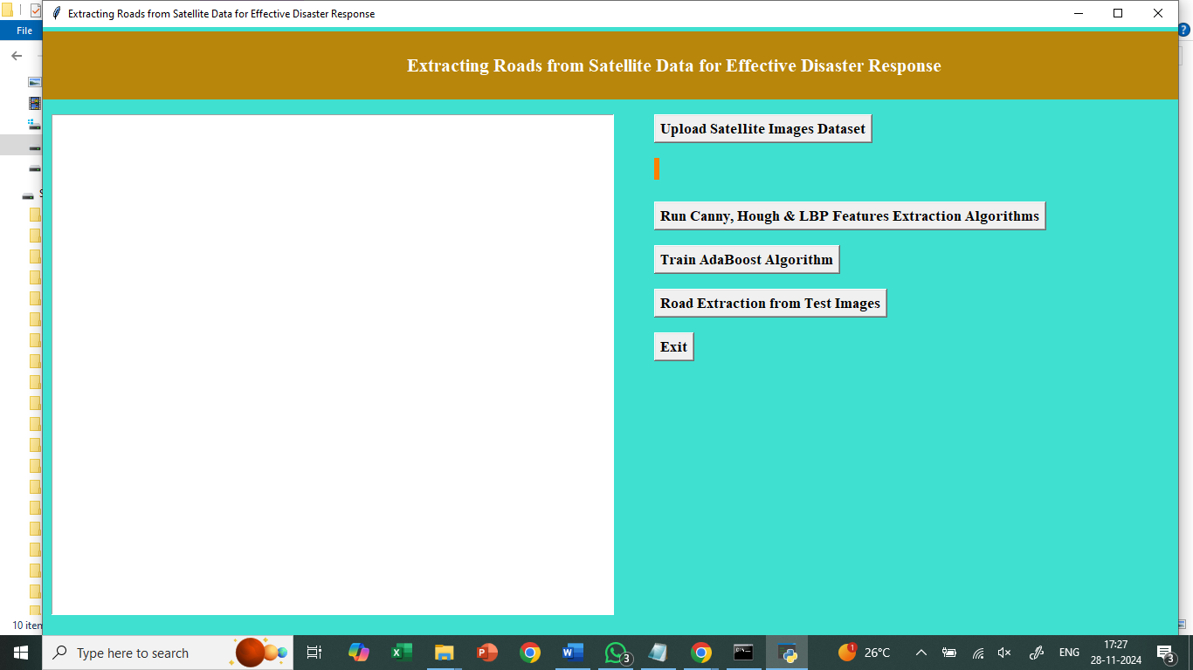
Implementation of proposed systems
Fig.1 Interface

Slide 23
CONCLUSION

Slide 24
conclusion
In this project we are using adaboost machine learning algorithm to extract road from satellite images. To train adaboost author is using quick bird satellite images dataset and then applying various features extraction technique such canny edge detection, hough line and LBP to extract features from images and then this extracted features will be input to adaboost for learning or training a model. This adaboost trained model can be applied on any test satellite image to extract road as adaboost trained on straight lines features so it can predict straight line road from any test images

Slide 25
FUTURE
DIRECTIONS

Slide 26
FUTURE DIRECTIONS
Incorporating Additional Data Sources: Combining satellite imagery with other data sources like LiDAR, radar, and social media data can improve the accuracy and robustness of road extraction.
Developing More Advanced Deep Learning Models: Exploring more advanced deep learning architectures, such as transformers and graph neural networks, can further enhance the performance of road extraction systems.
Addressing Edge Cases and Challenging Scenarios: Developing techniques to handle challenging scenarios like heavily obscured roads, narrow roads, and roads in dense urban areas is an important area of research.
By addressing these challenges and exploring future directions, we can continue to improve the accuracy, efficiency, and effectiveness of road extraction systems for disaster response and other applications.

Slide 27
REFERENCES

Slide 28
references
1. S. Hinz, A. Baumgartner, C. Steger, H. Mayer, W. Eckstein, H. Ebner and B. Radig, “road extraction in rural and urban areas,” semantic modeling for the acquistion of topographic information from images and maps, pp. 7-27, 1999.
2. S. Hinz, “automatic road extraction in urban scenes and beyond,” ISPRS, vol. 35, pp. 349-354, july 2004.
3. K. Price, “road grid extraction and verification,” international archives of photogrammetry and remote sensing, vol. 32, part 3-2W5, pp. 101-106, 1999.
4. D. M. Mckeown and J. L. Denlinger, “cooperative methods for road tracking in aerial imagery,” CVPR, pp. 662-672, 1988.
5. Meir barzohar and david B. Cooper, “automatic finding of main roads in aerial images by using geometric-stochastic models and estimation,” IEEE trans. PAMI, vol. 18, no. 7, pp. 707-721, july 1996. 6. Geman, D., B.Jedynak, “an active testing model for tracking roads in satellite images,” IEEE trans. PAMI, vol.18, no.1, pp.1-14, january 1996.

Slide 29
THANK YOU

